Slide 1
Methanococcus Meeting
June 6, 2014
ISB

Slide 2
Overview
General modeling
Updates to model
Updated acetate pathway
Future

Slide 3
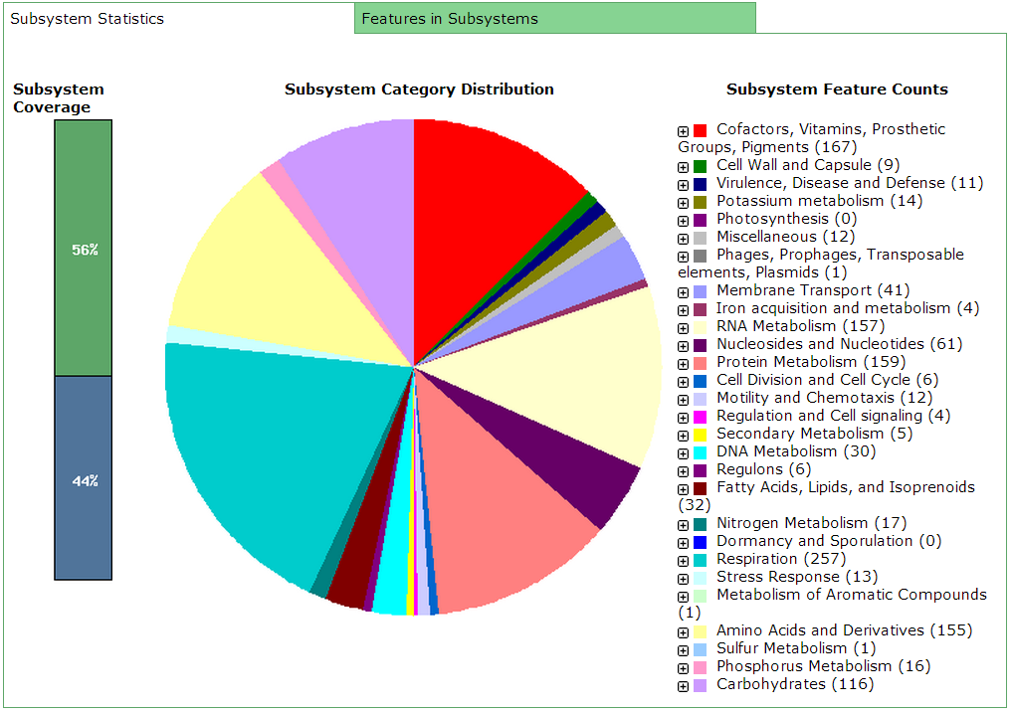
General Modeling
Step 1: Annotate the genome

Slide 4
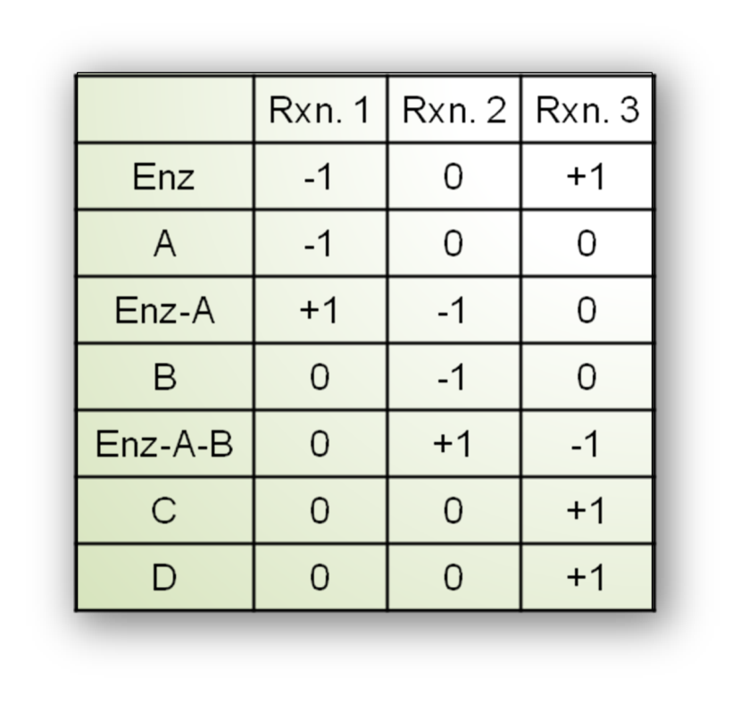
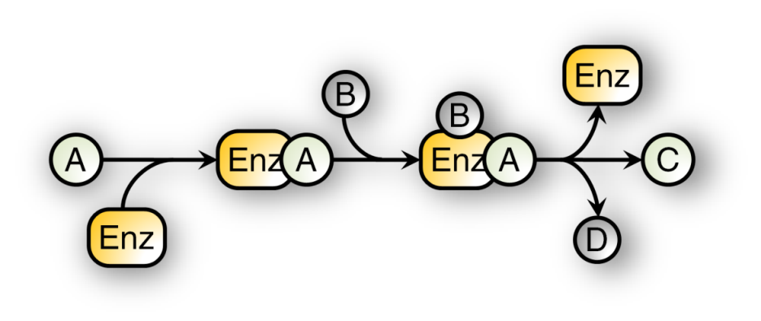
General Modeling
Step 2: Reconstruction → Model
Metabolic reaction
Stoichiometric matrix

Slide 5
Math Aside: Model Simulation
Constrain reaction fluxes (v):
Define a biomass objective to maximize:
Apply the steady-state assumption: S∙v=0
v_{upper} =1000 ; v_{lower} = 0
AAs + NAs + ATP + … → Biomass + ADP + P_{i} + …

Slide 6
General Modeling
Step 3: Gapfilling for model growth
?
P = 70%
P = 40%
P = 70%
P = 40%
P = 90%
P=80%
P=90%
P = 90%
P=80%
P=90%
Shortest Path
Highest Likelihood

Slide 7



General Model
Step 4: Manual curation for biological correctness
Step 5: Compare to experimental data and tune the model

Slide 8
Model Updates
Draft
724 metabolites
708 reactions
May 8
412 genes
735 metabolites
June 6
414 genes
736 metabolites
388 genes
730 reactions
722 reactions

Slide 9
Model Updates
Added acetate uptake and transporter
Added CO dehydrogenase, acetaldehyde oxidoreductase, Arg carboxy-lyase
Changed gene associations
Charge balanced all reactions
Removed 12 compounds from media
Removed metals (Zn, Cu, Mn) from the model’s media and its biomass

Slide 10
Acetate Problem
Initial model contained 2 acetate-CoA ligase reactions:
Based on literature, only the AMP reaction is present and is irreversible
rxn00175_c0: H_c0 + CoA_c0 + Acetate_c0 + ATP_c0
<=> Acetyl-CoA_c0 + PPi_c0 + AMP_c0
rxn00172_c0: CoA_c0 + Acetate_c0 + ATP_c0 ->
Acetyl-CoA_c0 + Phosphate_c0 + ADP_c0

Slide 12
Acetate Problem
Solution: find reactions that are currently irreversible in the model and allow model growth when made reversible
rxn12512_c0 ATP_c0 + L-Cysteine_c0 + 4-phosphopantothenate_c0
-> PPi_c0 + R-4'-Phosphopantothenoyl-L-cysteine_c0 + AMP_c0
rxn00675_c0 CoA_c0 + Propionyladenylate_c0
-> AMP_c0 + Propionyl-CoA_c0
rxn00549_c0 H2O_c0 + D-fructose-1_6-bisphosphate_c0
-> H_c0 + Phosphate_c0 + D-fructose-6-phosphate_c0
rxn00147_c0 H2O_c0 + ATP_c0 + Pyruvate_c0
-> H_c0 + Phosphate_c0 + Phosphoenolpyruvate_c0 + AMP_c0

Slide 13
Acetate Problem
Solution: find reactions that are currently irreversible in the model and allow model growth when made reversible
rxn12512_c0 ATP_c0 + L-Cysteine_c0 + 4-phosphopantothenate_c0
-> PPi_c0 + R-4'-Phosphopantothenoyl-L-cysteine_c0 + AMP_c0
rxn00675_c0 CoA_c0 + Propionyladenylate_c0
-> AMP_c0 + Propionyl-CoA_c0
rxn00549_c0 H2O_c0 + D-fructose-1_6-bisphosphate_c0
-> H_c0 + Phosphate_c0 + D-fructose-6-phosphate_c0
rxn00147_c0 H2O_c0 + ATP_c0 + Pyruvate_c0
-> H_c0 + Phosphate_c0 + Phosphoenolpyruvate_c0 + AMP_c0

Slide 14
Future Direction
Modeling issues to address:
Examining predictions on formate + CO₂
Vitamins and HCO₃ in the media
Matching yields:
Currently over an order of magnitude off
Can tune with ATP maintenance
Measured Yield Coefficient: 2.86 +/- 0.58 g(DCW)/mol CH4
Predicted Yield Coefficient: 60.421 g(DCW)/mol CH4

